Slide 1
Difference between Batch Processing and Stream Processing
Pravin Y Pawar

Slide 2
Batch Processing System
Defined
An efficient way of processing high volumes of data is where a group of transactions is collected over a period of time
Data is collected, entered, processed and then the batch results are produced
Hadoop is focused on batch data processing
Requires separate programs for input, process and output
Huge volume of storage is required
Data is sorted and then processed in sequential manner
No hard timelines defined
Sequential jobs are executed in repeated manner over fixed interval
An example is payroll and billing systems

Slide 3
Streaming Data Systems
Defined
Involves a continual input, process and output of data
Data must be processed in a small time period (or near real time)
Apache Storm, Spark Stream processing are frameworks meant for the same
Allows an organization the ability to take immediate action for those times when acting within seconds or minutes is significant
No storage required if event need not be stored
Data is processed as and when its made available to the system
Processing has to happen in fixed / hard time lines
Examples Radar systems, customer services and bank ATMs

Slide 4
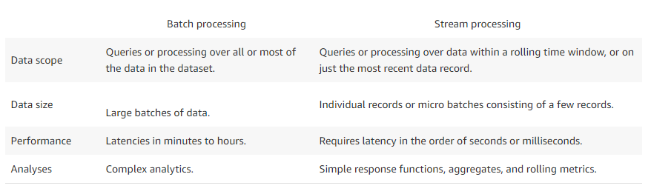
Difference
Source : https://aws.amazon.com/streaming-data/

Slide 5
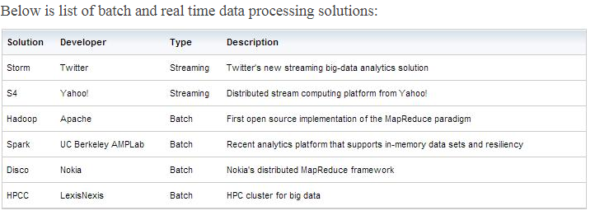
Frameworks
Source : https://www.datasciencecentral.com/profiles/blogs/batch-vs-real-time-data-processing

Slide 6
Thank You!
In our next session: Difference between real-time and streaming systems

